Slide 1
Unit 5:
Taxonomy of educational objectives

Slide 2
Unit Learning Outcomes
Explain the term taxonomy and taxonomy of educational objectives to provide a foundation for understanding how to categorize and structure educational objectives
Differentiate taxonomies of educational objectives to help recognize the diversity of learning objectives across cognitive, emotional, and physical domain
Formulate effective educational objectives to ensure that teaching is focused, and students have clear expectations, for successful learning outcomes.

Slide 3
Unit content
Definitions
    Taxonomy in general
    Taxonomy of educational objectives
Category of taxonomies
Defining effective educational objectives

Slide 4
Taxonomy
The word taxonomy is derived from two Greek words “taxis” which means arrangement or classification; and “nomos” which means law, science.
Thus, literally, the taxonomy is the science of classification.
It is the science of classification into ordered categories, the science of hierarchical classifications
To do the taxonomy is to make a list of elements that form categories concerning a particular domain, a particular science or discipline.

Slide 5
Taxonomy of educational objectives
In educational sciences, taxonomy is defined as a science of classification of behaviours.
Specifically in the teaching domain, it is about the expected behaviours of the student after he/she has learnt a given content of knowledge.
In pedagogy, we talk about taxonomy of educational objectives to indicate the hierarchical classification of educational objectives.
Taxonomy of educational objectives define and distinguish different levels of objectives

Slide 6

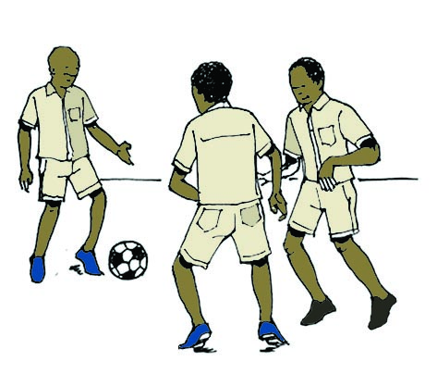


Taxonomy of educational objectives: Discuss these pictures

Slide 7
Taxonomy of educational objectives
During the teaching–learning process, the teacher constantly assesses the expected students’ behaviours.
Generally, these behaviours are classified into three categories referring to the aspects or domains of manifestation of human behaviour which are cognitive, affective and psychomotor domains.
Therefore, there are cognitive behaviour, psychomotor behaviour, and affective or emotional behaviour.

Slide 8
Three types of educational objectives
The three categories of behaviours mentioned above correspond to three categories of educational objectives.
Consequently, the taxonomy of educational objectives is simply the classification of educational objectives in relation to a hierarchical plan which allows analysis of a general pedagogical intention so that diverse levels of achievement can be identified.

Slide 9
Three domains of human behavior
Educational objectives are linked to any of the three domains of human behaviour, namely:
The cognitive domain in relation to intelligence or the “brain”
The affective domain, in relation to emotions, feelings or “heart”
The psychomotor domain, in relation to movements or the “body”

Slide 10
Educational objectives
In fact, teaching aims at developing the three types of educational objectives:
Cognitive objectives,
Psychomotor objectives, and
Affective objectives
These objectives are also placed at various levels of complexity (from simple to complex) in their respective domains, according to their hierarchical classifications (their levels)

Slide 11
Three main taxonomies of educational objectives
Bloom’s Taxonomy of cognitive objectives and its Revised Version
Krathwohl’s Taxonomy of Affective Objectives
Dave’s Taxonomy of psychomotor objectives

Slide 12
Bloom’s Taxonomy of cognitive objectives and its Revised Version
A) Old Bloom’s taxonomy
In 1948, following the congress in which a discussion was engaged about the content and the form of exams, a team headed by B. S. Bloom undertook a critical study on produced examination subjects.
The first classification was produced in 1951 and was sent to educators for critics and comments.
After so many modifications, they came up with the taxonomy of objectives in the cognitive domain in 1956.
It was called “Bloom’s taxonomy”.

Slide 13
Cognitive objectives
Cognitive objectives are related to knowledge acquired by learners, to the content taught.
They focus on developing students' intellectual abilities, such as thinking, reasoning, and problem-solving skills
Examples:
Define the term 'photosynthesis' and explain its importance in plant biology
Explain the importance of educational objectives
Compare and contrast teaching methods and teaching strategies in terms of scope, focus and the role of the teacher.

Slide 14
Activity
In small groups, discuss the importance of cognitive objectives

Slide 15
Different levels of Bloom’s taxonomy
Bloom’s taxonomy of the cognitive domain has six levels: Knowledge, comprehension, application, analysis, synthesis and evaluation.
In order to establish various levels of taxonomy, Bloom and his team identified mental processes that learners could use to learn the content, to solve a problem, or to answer a question.
The teacher should assess these processes in order to verify at what degree the didactic action has contributed to their achievement.

Slide 16
(i) Knowledge
Knowledge is the lowest level of mental behaviour, involving the recognition and recall of facts, terms, basic concepts.
To evaluate knowledge is to judge what another person knows.
Knowledge is the memorisation and restoration or reminder of information that an individual has felt or perceived because any knowledge is acquired through sensation and perception.
Questions that evaluate knowledge are of the following type: state, list or what do you know about this or that, define the following terms, etc.
Example: the learners will be able to state the highest mountain in the world.
Key action verbs: list, define, name, identify, recall, describe, etc.

Slide 17
(ii) Comprehension
Is the level at which the student understands the facts he or she has learned by organizing, comparing, translating, interpreting, giving descriptions, and stating main ideas.
Key action verbs: explain, summarize, classify, interpret, paraphrase, discuss, differentiate, compare, contrast, etc.
Example: The learner will be able to explain the main categories of teaching and learning objectives.

Slide 18
iii)Application
Application is the use of learned material (acquired knowledge, general ideas, rules, principles, and theories ), in new and concrete situations.
The application can also be done outside the classroom setting.
In this case, it refers to the transfer of knowledge which is the use of knowledge acquired in another context different from the learning situation.
This allows him/ her to adapt him/herself to his/her environment and this is one of the main characteristics of an intelligent person.
Key action verbs: use, solve, build, demonstrate, apply, execute.

Slide 19
(iv) Analysis
To break down information into parts and examine relationships or patterns.
Key action verbs: differentiate, compare, contrast, categorize, examine, analyze, etc.
Examples:
Compare and contrast teaching methods and teaching strategies in terms of scope, focus and the role of the teacher.
Analyze the causes and effects of World War I from multiple perspectives (economic, political, social).
Students’ level of analysis is evaluated by questions such as why? How does it happen? etc.
You can also give the following theme: analyse the Rwandan education system and show its strengths and weaknesses.

Slide 20
(v) Synthesis
Analysis without synthesis is an incomplete science as the synthesis without analysis is imaginary.
Synthesis consists in reunifying elements and parts in order to remake the whole.
Example: Having studied the light reflection and the light refraction laws, construct an apparatus based on these laws.
The student will be able to design a new plan from the information given
The students bring together knowledge possessed in new way to create new outcomes.

Slide 21
(vi) Evaluation
Evaluation is the highest level of thinking in Bloom’s taxonomy
It implies that the learner can think logically about an issue in relation to specific reference points.
Evaluation consists of making a critical judgment based on the value of the material in accordance with certain criteria
The students present and defend opinions by making judgments about information, validity of ideas, or quality of work based on a set of criteria or standards, and justify decisions.
Examples: The student will assess the role of women in development in Rwanda, critique the methodology used in a research study.
Key action verbs: evaluate, critique, judge, assess, defend, argue, justify.

Slide 22
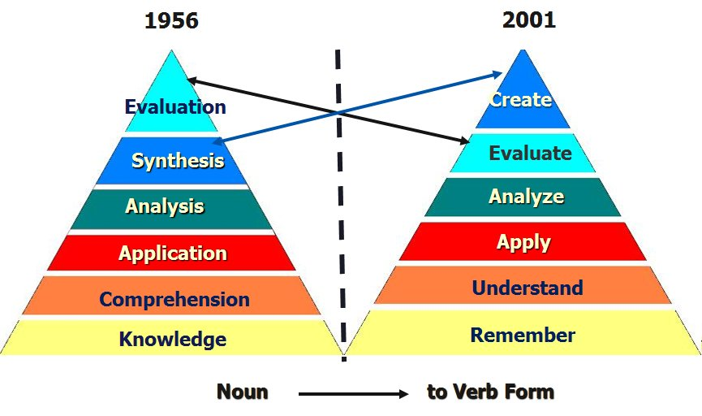
B. The revised Bloom’s taxonomy

Slide 23
Changes in the new revised Bloom’s taxonomy
The names of six major categories were changed from noun to verb forms.
As the taxonomy reflects different forms of thinking and thinking is an active process verbs were used rather than nouns.
The subcategories of the six major categories were also replaced by verbs and some subcategories were reorganised.
The knowledge category was renamed.
Knowledge is an outcome or product of thinking not a form of thinking per se.
Consequently, the word knowledge was inappropriate to describe a category of thinking and was replaced with the word remembering instead.
Comprehension and synthesis were retitled to understanding and creating respectively, in order to better reflect the nature of the thinking defined in each category.

Slide 24
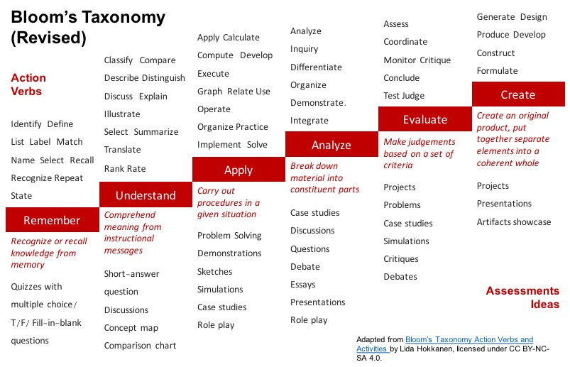
Revised bloom’s taxonomy

Slide 25
Note:
Teachers shall use the revised Bloom’s taxonomy which has been found to satisfy the 21st century teaching and learning.

Slide 26
Krathwohl’s Taxonomy of Affective Objectives
The taxonomy, developed by David Krathwohl in 1964, focuses on the emotional domain of learning and emphasizes the development of attitudes, values, and feelings.
The taxonomy describes how learners engage with emotional responses to stimuli, such as how they feel about a subject, their willingness to engage in specific behaviors, or the value they place on ideas and concepts.
It guides teachers in fostering not just intellectual but also emotional development in students.

Slide 27
Krathwohl’s Taxonomy of Affective Objectives
The taxonomy is related to the affective domain which includes the manner in which we deal with things emotionally, such as feelings, values, appreciation, enthusiasm/interest, motivation and attitudes.
The domain of affectivity comprises emotions, sentiments, passions, etc.
Briefly, it is comprised of whatever is related to pleasure and displeasure.

Slide 28
Krathwohl’s Taxonomy of Affective Objectives
This domain is also called the domain of attitudes.
An attitude is understood as an internal disposition of the person that is expressed through learned and moderated emotional reactions and then felt every time when that person faces an object, a situation, an idea or an activity.
These emotional reactions make the person to be favourable or unfavourable towards that object.

Slide 29
Levels of Krathwohl’s Taxonomy of Affective Objectives
Krathwohl, in his taxonomy, put up five processes in the acquisition of attitudes which correspond to five taxonomic levels to be evaluated in the learners in order to ensure the achievement of affective objectives
Each level describes how students may change their attitudes, values, and feelings toward something.
The five hierarchical levels, progress from the simplest to the most complex emotional responses:Receiving, Responding, Valuing, Organization and Characterisation.

Slide 30
(i)Receiving (Level of awareness)
At this level, learners are simply aware of or willing to receive information or stimuli.
The learner is sensitised about the existence of certain phenomena and stimuli.
He/she is incited to receive them and pay attention to them
It involves the passive process of attending to something and being open to it.
Key action verbs: listen, pay attention, notice, observe, be aware.
Examples:
  Listen attentively to a class discussion on environmental issues.
  Observe the ethical behavior demonstrated by a role model.
  Larners receive sounds, get knowledge of the existence of the school regulation, learners listen the music on radio, etc.

Slide 31
(ii) Responding (Level of participation)
This is a reaction to an event.
The learner reacts beyond the simple attention aiming at discovering more and feels the pleasure to go deep.
Learners actively participate in or respond to stimuli. This could involve following instructions, providing feedback, or engaging in a specific activity
He/she is sufficiently engaged in the object, a phenomenon or an activity in order to discover it.
Examples: students will give a clap after a speech; they accept that the school regulation be respected or will participate in the drama festival. Participate in a group discussion about the importance of teamwork. Complete a survey to express opinions on school policies.
Key action verbs: respond, participate, discuss, answer, contribute, react.

Slide 32
(iii) Valuing (Level of value development)
Learners begin to attach value or importance to specific ideas, behaviors, or concepts.
This level is characterized by forming attitudes or preferences, often influenced by personal beliefs.
This involves internalizing a belief.
It is the behaviour which is solid and stable to be characterised as belief or attitude.
The learner manifests the behaviour with sufficient coherence in appropriate circumstances to be esteemed as being linked to the internalisation of the value.

Slide 33
Valuing (Level of value development)
The behaviour is motivated, not by the desire to please or to obey, but through the individual engagement to the fundamental value determining the behaviour.
For example, to respect the school regulation at all occasions or four learners will sponsor one student to go for a cultural show at Serena Hotel, demonstrate a commitment to protecting the environment by recycling, respect for the opinions of others in class discussions.
Key action verbs: value, appreciate, prefer, demonstrate commitment to, believe in

Slide 34
(iv) Organization (level of value system)
This involves commitment to a set of values
It is about arranging values in a system, determine interrelations that exist between them, establish those that are dominant and deeper as well as differences.
Learners organize values into a coherent value system, integrating different values into a broader structure.
This stage often involves prioritizing and reconciling conflicts between values.
Ex: Students will organize themselves in study groups of four persons; Organize a community service project based on personal values of social responsibility.
Key action verbs: organize, integrate, compare, prioritize, formulate.

Slide 35
(v) Characterisation (level of internalizing Values)
At the highest level, learners internalize values so that they consistently act in accordance with them.
These values become part of the learner’s character, influencing behavior and decision-making across various situations
A student has value system to the extent that represents a philosophy of life.
For example, the students will be bound by the school rules and regulations at all times, actively demonstrate leadership and integrity in all aspects of personal and professional life, consistently act in a manner that reflects respect for others and personal ethical standards.
Key action verbs: act, demonstrate, influence, embody, internalize.

Slide 36
Affective objectives
Affective objectives occur at all levels of the teaching/learning process, but they are often neglected because they belong to the domain of attitudes.
Examples:
To fulfill someone’s commitments;
To like mathematics
To stick to deadline of an appointment
!! It is difficult to assess these objectives, to find verbs of action

Slide 37
Example of Learning Objectives Using Krathwohl’s Taxonomy:
Receiving: Listen attentively to a lecture on diversity and respect different cultural perspectives.
Responding: Participate in a class discussion by sharing personal experiences related to teamwork.
Valuing: Show appreciation for others' contributions in group projects, demonstrating respect for differing opinions.
Organizing: Integrate the concepts of social justice and equality into a personal code of ethics and demonstrate this through actions in the community.
Characterizing: Consistently embody ethical leadership by advocating for fairness and transparency in professional settings.

Slide 38
Dave’s Taxonomy of psychomotor objectives
The psychomotor domain encompasses the skills requiring the use and coordination of skeletal muscles, as in the physical activities of performing, manipulating, and constructing.
Psychomotor skills are typically more observable, easier to describe, and measure in terms of evaluation.
This taxonomy helps educators design and assess activities that involve physical movement, coordination, and manual skills, focusing on how learners develop proficiency in performing tasks that require fine and gross motor skills
In general, these objectives are developed in Physical Education as well as other technical and vocational training courses.
Examples: Draw, sing, high jump, disassemble an engine, etc.

Slide 39
Taxonomy of psychomotor objectives
There is no taxonomy that is accepted universally for this domain.
A very popular model for the psychomotor domain was established by R.H. Dave
This domain concerns objectives related to motor capacities or manipulation.
This domain refers to body movements or motor orientation.

Slide 40
Levels of Dave’s Taxonomy of Psychomotor Objectives
This taxonomy has five levels:
Imitation
Execution
Precision
Coordination
Naturalization

Slide 41
(i) Imitation
The learner is able to observe and replicate a motor skill, following the teacher's demonstration.
This level involves copying actions, and the skill is typically performed with some guidance.
Performance may be of low quality
The learner repeats an observed action, but the neuromuscular coordination is still poor.
For example, Copying a work of art: the child takes a paper, rudely imitates a friend's drawing.
Key action verbs: imitate, follow, copy, repeat, duplicate.

Slide 42
(ii) Execution or manipulation
Learners are able to perform the skill or task on their own, though still relying on basic procedures or instructions.
The skill is performed with a greater degree of independence than in the imitation stage, but there is still some reliance on guidance.
The learner becomes capable of imitating the teacher's example.
He/she starts differentiating movements and choosing the adequate behaviour.
He/she reaches a certain level of ability in handling certain objects.
Ex: creating work on one’s own, after taking lessons or reading about it.
Key action verbs: manipulate, handle, practice, use, perform.

Slide 43
(iii) Precision
The learner performs the skill with increased accuracy, coordination, and control.
At this level, the task is completed with greater refinement and attention to detail, often without the need for explicit guidance.
The learner replicates the model with accuracy and precision.
He/she reproduces the required model perfectly.
He/she manages to replicate this action in the absence of the model.
He/she directs the action, and can modify its speed of execution with regard to the situation.
Key action verbs: perform precisely, perfect, refine, enhance, adjust.

Slide 44
(iv) Coordination or articulation
Learners coordinate and combine multiple skills to perform a complex sequence of actions smoothly and efficiently.
At this stage, learners are able to adapt and adjust their movements based on the situation, integrating various motor actions into a cohesive whole.
Coordinating a series of actions, achieving harmony and internal consistency.
The learner harmonises his/her action while being at the same time capable to adjust the speed, the duration, and the other factors, so that actions articulate well.
Example: Producing a video that involves music, drama, color, sound, etc.
The learner associates several words and knows how to write a text within a minimum time.
Key action verbs: combine, integrate, coordinate, blend, synchronize

Slide 45
(v) Naturalization
The learner performs the task with such a high level of proficiency that it becomes almost automatic or second nature.
This level represents mastery of the skill, where the learner can perform the task smoothly and efficiently without thinking about the individual steps.
Having high level performance become natural, without needing to think much about it. Things become automatic.
It is the internalisation, the habit or the second nature.
With a minimum psychic energy, the learner develops a quick and personalized writing.

Slide 46
Naturalization
Key action verbs: perform naturally, master, execute automatically, innovate, adapt.
Examples:
Michael Jordan playing basketball, Nancy Lopez hitting a golf ball, etc.
Drive a car skillfully in varying traffic conditions, without needing to consciously focus on basic driving tasks.
Perform a complicated surgical procedure smoothly and efficiently, with minimal effort or conscious thought.

Slide 47
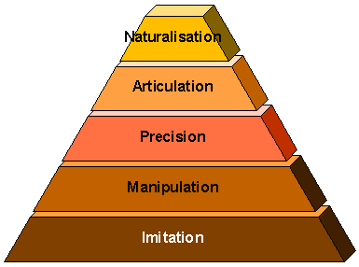
Dave’s Taxonomy of psychomotor objectives

Slide 48
Note:
When determining the objectives that learners should achieve at the end of their learning, the teacher must set these objectives with reference to the above domains of learning because, obviously, he/she must evaluate his/her educational action.

Slide 49
Instructional/learning objective
An objective is understood as a statement which describes an intended outcome of educational process.
It describes the kind of behaviour the learner is intended to display through thoughts, actions and feelings and the context in which the behaviour is to operate.
The rationale of objectives is given by Mager (2001) in his book How to define educational objectives while writing: ”If you don’t know where you are going, then there is a risk to be found elsewhere”.
In other words, “ If you do not know where you are going, how will you know when you get there”.

Slide 50
Functions of objectives
They serve as references and criteria to evaluate without any ambiguity whether the result is attained;
They serve as headlights (a powerful light at the front of them) and help the teacher and the learner to know at any time their position/situation in regard with the result to achieve;
They serve as means and criteria of self-assessment and improvement of action;
They serve as criteria for choosing methods, ways and strategies of the pedagogical action.

Slide 51
Functions of objectives
In short, the educational objectives allow:
To know where to go: to determine the difference between the initial situation and the final situation in order to see whether there is a change for the learner or not;
To know how to go there: by determining the stages to follow and by choosing the most relevant techniques which will help to reach what was determined before;
To know where we are: it is a question of making an objective evaluation;
Facilitate communication: between teachers and learners or among teachers themselves or even between teachers and other persons in charge of the system, inspectors, supervisors, etc

Slide 52
How to formulate learning objectives?
Objectives are statements of change for students
They should specify the kind of behaviour and the content or area in which the behaviour is to operate.
Normally, the learning objectives are formulated or defined using verbs of action and specifying the content of the action which must be precise and limited.
A well-written or formulated learning objectives should be SMART: Specific, Measurable, Achievable, Relevant, and Time-bound.

Slide 53
SMART learning objective
Specific: clearly describe the attitudes, skills and knowledge that the learner is expected to demonstrate after a given learning session.
Example: By the end of the lesson, students should be able to correctly conjugate 5 regular verbs in the present tense, on a vocabulary and conjugation quiz
Specific: conjugate 5 regular verbs in the present tense

Slide 54
SMART learning objective
Measurable: the achievement of the objective can be measured by an assessment strategy such as observation, test items or problem-solving exercises.
Example: By the end of the lesson, students should be able to correctly conjugate 5 regular verbs in the present tense, on a vocabulary and conjugation quiz
Measurable: correctly on a vocabulary and conjugation quiz

Slide 55
SMART learning objective
Achievable: attainable, realistic, doable given the time frame and the support or tools available.
Objective should be reasonable. It has to reflect reasonable expectations in terms of the attitudes, knowledge and skills to be acquired within the given time frame
Example: By the end of the lesson, students should be able to correctly conjugate 5 regular verbs in the present tense, on a vocabulary and conjugation quiz
Achievable: Realistic or attainable by the end of the lesson, 5 regular verbs can be done.

Slide 56
SMART learning objective
Relevant: meaningful and worth pursuing, significance, appropriate for the learner's current stage of development or subject objectives, aligns with real-world needs, the learner's interests, and the overall educational or developmental context.
Example: By the end of the lesson, students should be able to correctly conjugate 5 regular verbs in the present tense, on a vocabulary and conjugation quiz
Relevant: Supports language acquisition and mastery of verb conjugation

Slide 57
SMART learning objective
Time-bound: The learning objective should have a time limit, a specific timeframe or deadline for achieving a goal or completing a task.
It means that the objective has a clear start and end time, which helps create a sense of urgency and focus
This is usually done by using the phrase “by the end of this lesson” or by the end of the week, by the end of the unit, within two months, during the semester, by the end of the semester, etc.

Slide 58
How to write effective learning objectives?
Learning objectives are known to be made up of a number of components (Components of clear learning objectives).
The most known components are those identified by an educational theorist Robert Marger.
The four major components are ABCD:
Audience: Who is learning
Behaviour: What they will learn
Condition: Under what conditions
Degree: How well they must perform

Slide 59
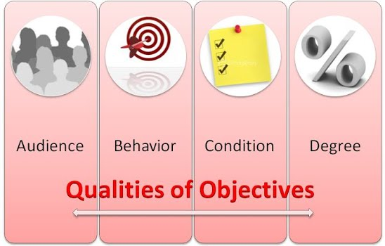
The four components of a clear learning objective

Slide 60
The four components of a clear learning objective
Audience (A): Learning objectives should always specify the audience they are intended to serve.
This refers to who the learning objective is aimed at — the group of learners or students.
Usually, the audiences are participants in the learning session.
For example, in the phrase “learners will be able,” the learners are the audience.

Slide 61
The four components of a clear learning objective
Behavior (B): Behaviors are observable actions that are supposed to be accomplished by the end of the lesson.
This component specifies what the learner is expected to do.
It refers to the observable and measurable action or behavior the learner should be able to perform after the learning experience
A clear learning objective should have an action verb that demonstrates the skills, Knowledge and attitudes to be acquired.
The action verbs should be able used :explain, identify, analyze, list, draw, write, demonstrate, calculate, describe, etc.

Slide 62
The four components of a clear learning objective
  It is important to avoid general verbs such as ‘know’ and ‘understand’ as they may not be measurable and thus present a lot of problems when it comes to assessing the effectiveness of the lesson.
  For instance, it is better to have an objective that says, “Learners will be able to list important markets for electronic products,” rather than “learners will know the important markets for electronic products.”

Slide 63
The four components of a clear learning objective
Condition (C): Learning objectives should identify under which conditions a given skill or knowledge must be achieved by the learner.
Conditions under which given tasks will be performed, under which the learner will perform the behaviour.
The conditions may include time, tools, place, resources, environment and circumstances under which the learner is expected to perform the behavior or in which the task will be performed.
Example: Using or without a calculator, without or referring to the notes, in a classroom setting, after reading the article, referring to a chart, or a map; while being monitored, on boat, in class, etc.

Slide 64
The four components of a clear learning objective
By the end of this lesson, the learner should be able to take less than five minutes to successfully calculate the area of a rectangle.
Here the phrase “less than five minutes” represents the condition.
The teacher want to answer the questions:
What will you give or not give the learner to use?
What will the environment be?

Slide 65
The four components of a clear learning objective
Degree (D): This defines the level of proficiency or the standard the learner needs to achieve.
It specifies how well the learner should perform the behavior and may include criteria such as accuracy, speed, or completeness.
Example: With 90% accuracy or accurately, under 10 minutes, at a rate of 20 words per minute, without error, correctly, with confidence, etc.
The teacher may want to answer: How many?, How fast?, How well?
It is, therefore, important for a teacher to give the specifics of how a learner will be able to perform a given task in terms of quality, quantity and /or time measurements.

Slide 66
The four components of a clear learning objective
For example, in the objective, “…the learners should be able to identify the factors that contribute to the rise of Ghana Empire at 95% …” the phrase at 95% is the standard (Attention!!!% are not appreciated in Rwanda).
Better to say: the learner should be able to correctly identify the factors that contributed to the rise of Ghana Empire.

Slide 67
Example of an ABCD Learning Objective
By the end of this lesson, students (A) should be able to solve(B) quadratic equations using a calculator (C) with 100% accuracy (D).
Audience: Students
Behavior: Solve
Condition: Using a calculator
Degree: With 100% accuracy or accurately.

Slide 68
How to write effective learning objectives: verbs of action and levels of cognitive objectives

Slide 69
Activity
In small group, select a topic from the subject you will teach in secondary school and formulate an effective learning objective (that is SMART and with ABCD components).
Indicate what makes the formulated learning objective SMART with ABCD components.
Present in plenary

Slide 70
Check your progress
Define taxonomy and taxonomy of educational objectives
Explain different levels of cognitive, psychomotor and affective objectives
Consider one lesson from the subject you will teach in secondary schools and formulate a SMART objective with ABCD component.

Slide 71
END!!

