Slide 1
Stem Structures
Stems contain a variety of structures that aid it in it’s functions.

Slide 2
Nodes and Intenodes
Stems care divided into internodes.
At each end of an internode is a node.
A node is a structure on a stem at which two or more leaves are attached

Slide 3
Buds
At the point of attachment of each leaf the stem bears a lateral bud.
A bud is capable of developing into a new shoot.
Buds contain an apical meristem enclosed by specialized leaves called bud scales.

Slide 4
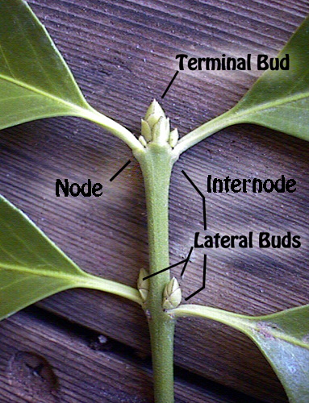

Slide 5
Types of Stems

Slide 6
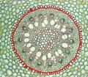

Monocots
Contain parallel veins
The shoot apex in monocot stems is more elongated. Leaf sheathes grow up around it, protecting it. Monocot leaves have continuous vascular tissue going down from a shoot or stem.

Slide 7
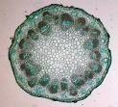

Dicot
Dicot stems have a pith in the center with vascular tissues in a distinct ring visible in a cross section.

Slide 8
Primary and Secondary Growth in Stems
.hctib ytrid a s
i rolyaT

Slide 9
Primary Growth

