Slide 1
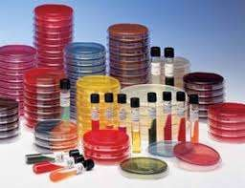
Types of culture media

Slide 2
What is culture medium
The food material or substances required for growing microorganisms in vitro (outside the body) is called culture medium.

Slide 3
Uses of culture medium
It is important to grow microorganisms outside the body for the following purposes:
to identify the cause of infection from the clinical sample, so that proper treatment can be given.
to study the characteristics or properties of microorganisms.
to prepare biological products like vaccines, toxoides, antigens…etc.

Slide 4
Composition of culture media
Water
Energy source
Carbon source
Nitrogen source
Mineral salts
Special growth factors

Slide 5
Types of culture media
Classification based on physical state
  solid medium
  semi solid medium
  liquid medium

Slide 6
Classification based on the ingredients
  simple medium
  complex medium
  synthetic or defined medium
  Special media

Slide 7
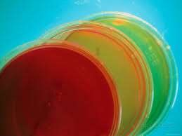
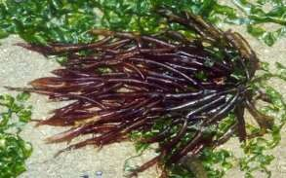
Classification based on physical state
Solid medium
agar is the most commonly used solidifying agent.
What is agar
Golden –yellow granular powder
Prepared from seaweeds.
Not affected by the growth of the bacteria
Melts at 98ºC & sets at 42ºC
.

Slide 8
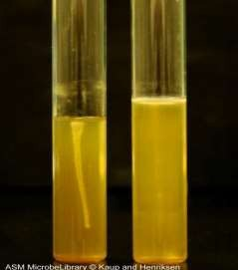
Semi-solid media
Such media are soft and are useful in demonstrating bacterial motility and separating motile from non- motile strains .

Slide 9
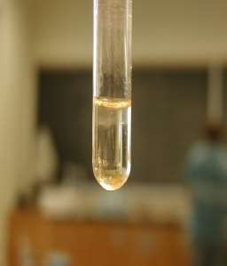
Liquid media
are sometimes referred as “ broth “.
bacteria grow uniformly producing general turbidity eg. Nutrient broth

Slide 10
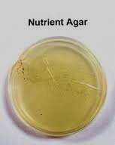
Classification based on the ingredients
Simple media
eg: Nutrient broth, N. agar
NB consists of peptone, meat extract, NaCl,
NB + 2% agar = Nutrient agar

Slide 11
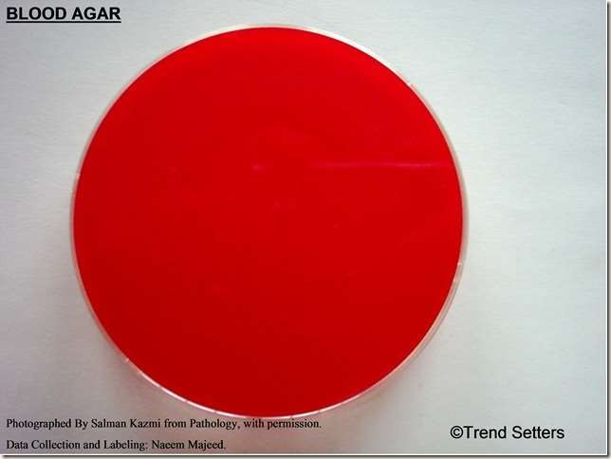
Complex media
such as blood agar, it has ingredients that exact components are difficult to estimate.

Slide 12
Synthetic or defined media
specially prepared media from pure chemical substances for research purpose and composition of every component is well known
eg: peptone water –
1% peptone + 0.5% NaCl in water.

Slide 13
Special media
Enriched media
Selective media
Differential media
Transport media
Anaerobic media

Slide 14
Enriched media
Substances like blood, serum, egg are added to the simple medium.
Used to grow bacteria that are exacting in their nutritional needs.
eg: Blood agar, Chocolate agar

Slide 15
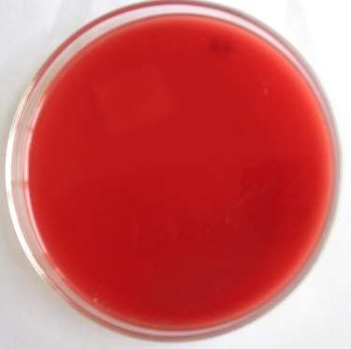
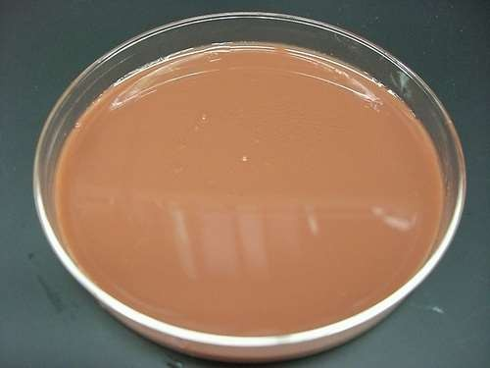
Blood agar
BAP contains mammalian blood(usually sheep or horse) typically at a concentration of 5-10%, used to isolate fastidious organisms and detect
hemolysis.
Chocolate agar
contain red blood cells that have been lysed by
slowly heating to 80 c .and it used for growing fastidious bacteria, such as Haemophilus influenzae

Slide 16
Selective media
The inhibitory substance is added to a solid media to inhibit commensal or contaminating bacteria such as :
Antibiotics
Dyes
Chemicals
Alteration of pH

Slide 17
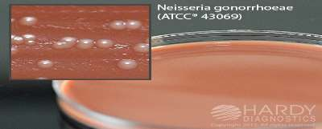
Examples
Thayer Martin medium
selective for Neisseria gonorrhoeae
It usually contains the following combination of antibiotics:
Vancomycin:
which is able to kill most Gram-positive organisms.
Colistin,:
which is added to kill most Gram-negative organisms except Neisseria.
Nystatin,:
which can kill most fungi
Trimethoprim:
which inhibits Gram-negative organisms, especially swarming Proteus.

Slide 18
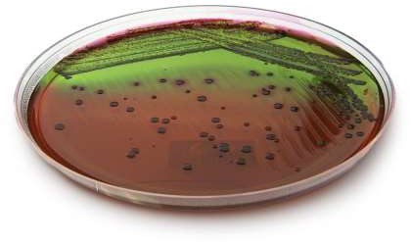
Eosin methylene blue
selective for gram negative bacteria
The dye methylene blue in the medium inhibit the growth of gram positive bacteria.

Slide 19
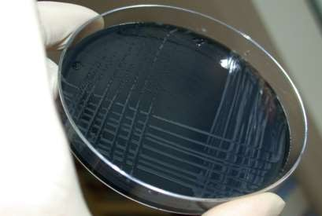
Campylobacter agar
Is used for isolation of Campylobacter jejuni from fecal or rectal swab.
Contain Bacteriological charcoal , Cefoperazone and
Amphotericin B.

Slide 20
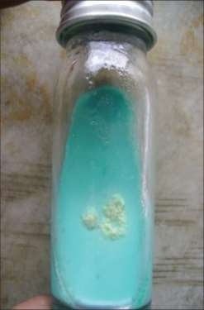
Lowenstein –Jenson medium
is solid medium used for
Mycobacterium tuberculosis.
contain penicillin, nalidixic acid and malachite green to inhibit growth of gram positive and gram negative bacteria, in order to limit growth to Mycobacteria species only.

Slide 21
Differential media
are designed in such a way that different bacteria can be recognized on the basis of their colony color.
Dyes and metabolic substrates are incorporated so that those
bacteria that utilize them appear as differently colored colonies.
Examples:
MacConkey agar
CLED agar
TCBS agar
XLD agar

Slide 22
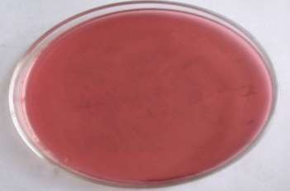
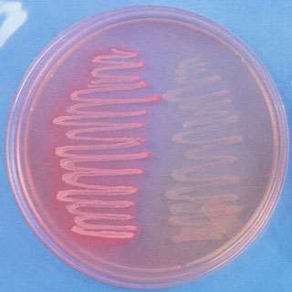
Examples
MacConkey medium
Distinguish between lactose fermenters & non lactose fermenters.
Lactose fermenters – Pink colonies
Non lactose fermenters – colorless colonies

Slide 23
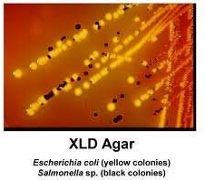
Examples
Xylose Lysine Deoxycholate Agar(XLD)
Used for the recovery of Salmonella and Shigella
species.

Slide 24
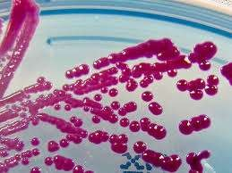
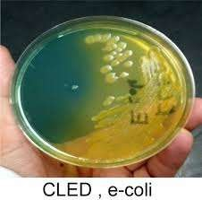
Examples
Cysteine Lactose Electrolyte Deficient Agar(CLED)
For cultivation of pathogen from urine specimen , inhibit swarming of proteus sp.
CLED, serratia

Slide 25
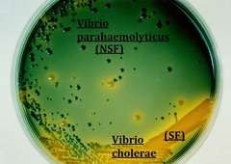
Examples
Thiosulfate-citrate-bile salts-sucrose agar(TCBS)
highly selective for the isolation of V. cholerae and V. parahaemolyticus
Yellow coloured (sucrose fermenting) colonies
of Vibrio cholerae on TCBS agar.

Slide 26
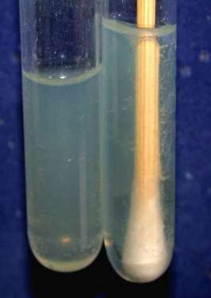
Transport media
Media used for transporting the samples.
Delicate organisms may not survive the time taken for transporting the specimen without a transport media.
Eg:
  Stuart’s medium
  Buffered glycerol saline

Slide 27
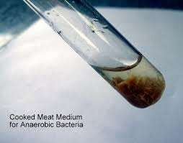
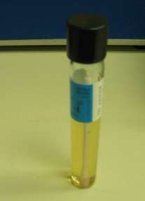
Anaerobic media
These media are used to grow anaerobic organisms.
Eg:
Robertson’s cooked meat medium.
Thioglycolate broth medium.

Slide 28
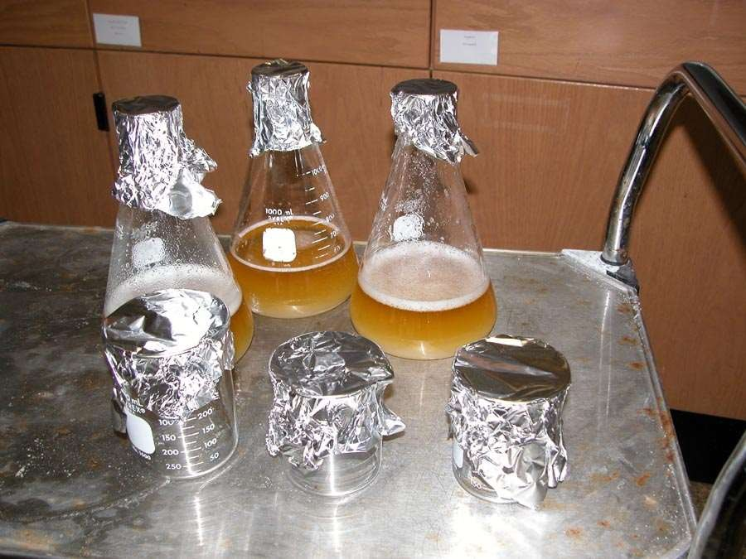

Media Preparation

Slide 29
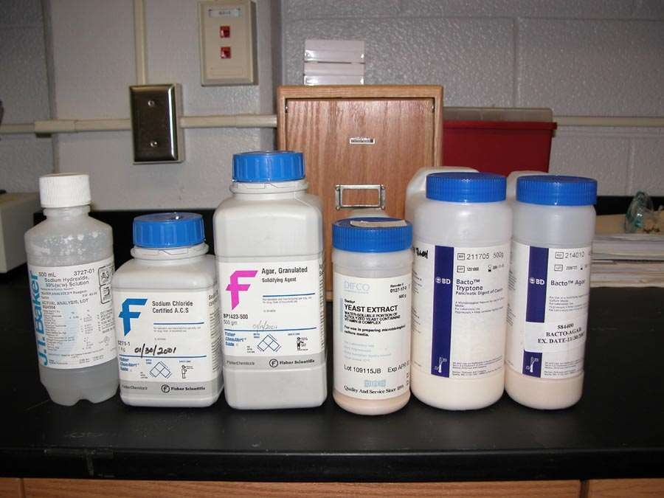
Assemble all of your chemicals in your work area before you begin.

Slide 30
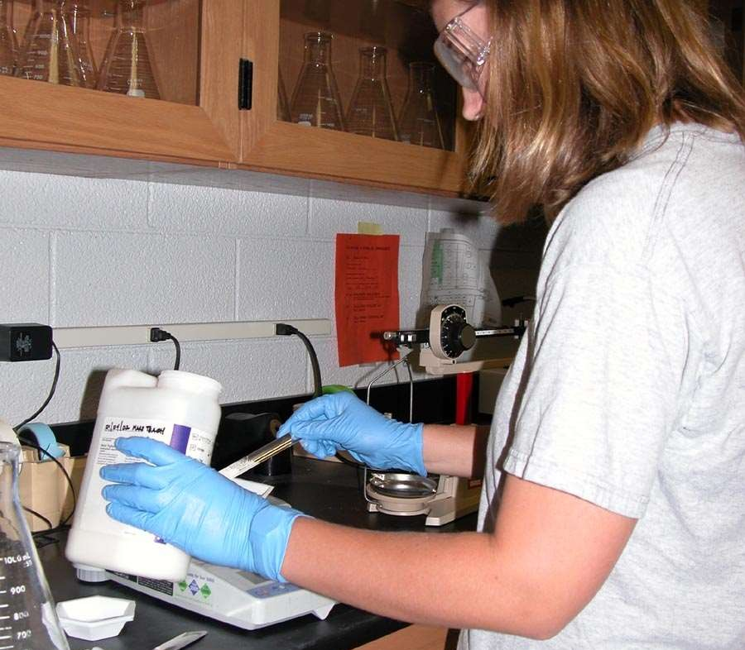
Accurately weigh each of the dry ingredients in your culture media.

Slide 31
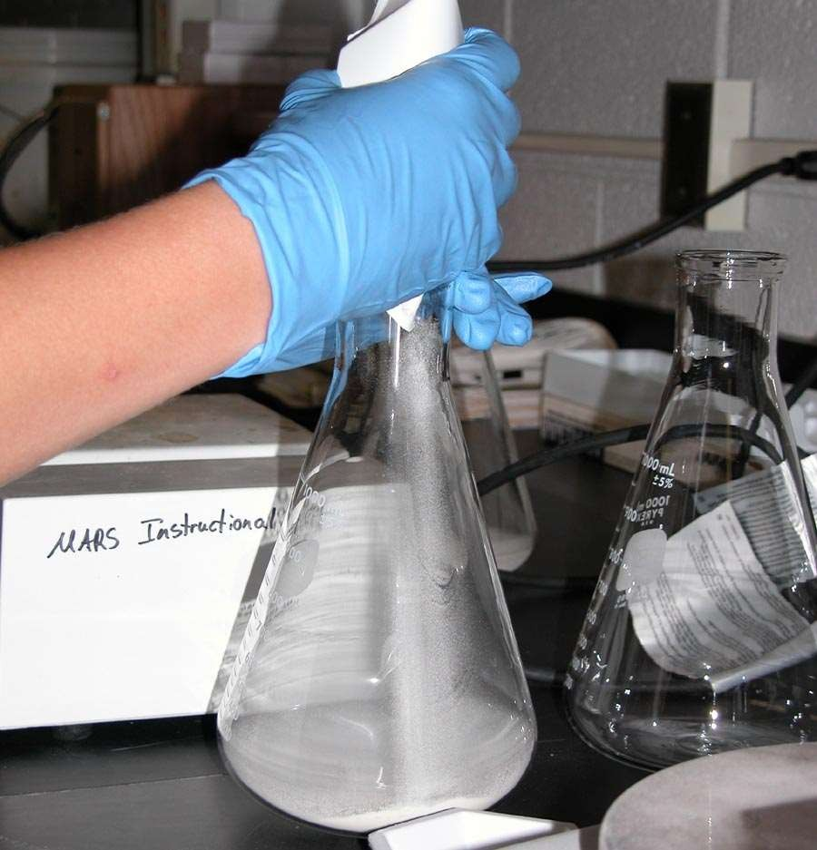
Add each dry culture medium ingredient into a flask.

Slide 32
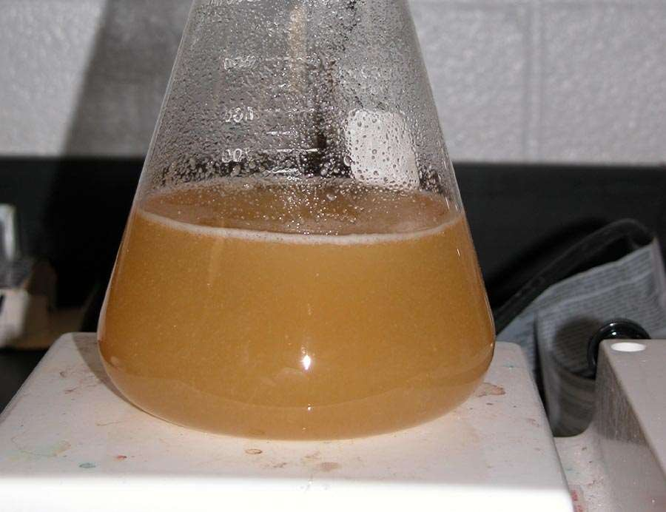
Add distilled water to make the correct volume. Heat AND stir (agar will burn if it is not stirred) until all of the ingredients go into solution. When the media boils, it is ready for sterilization.

Slide 33
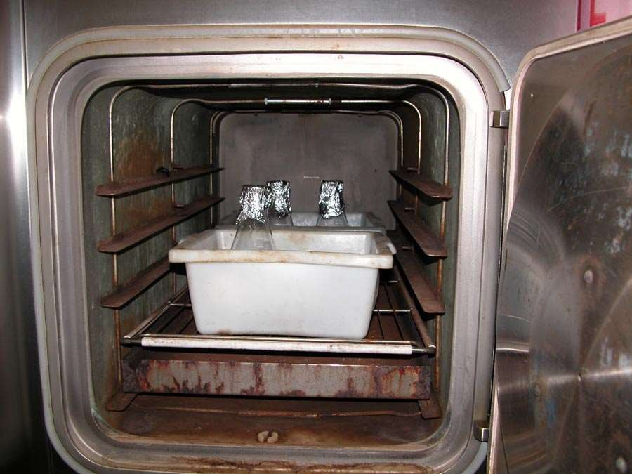

Media Sterilization

Slide 34
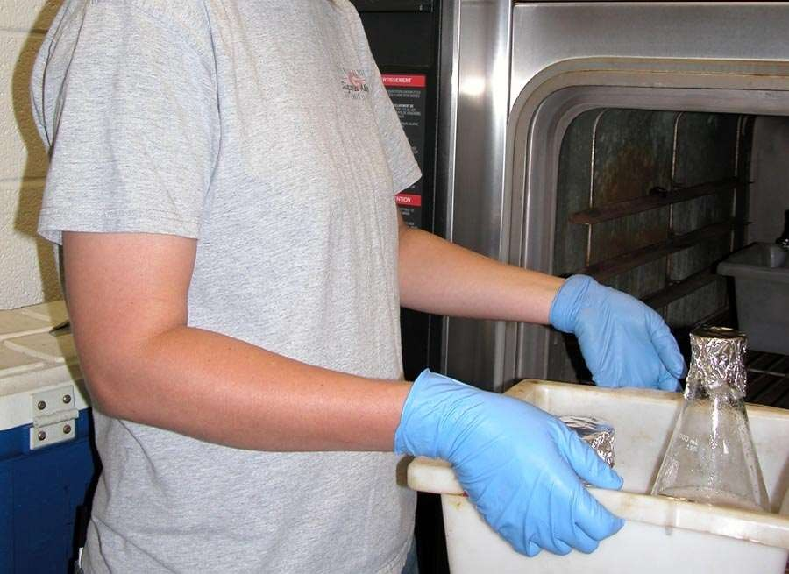
Sterilize by using the wet cycle (autoclave) .
Remember to cover the top of the flask or jar with aluminum foil to prevent contamination when as the media cools.

Slide 35
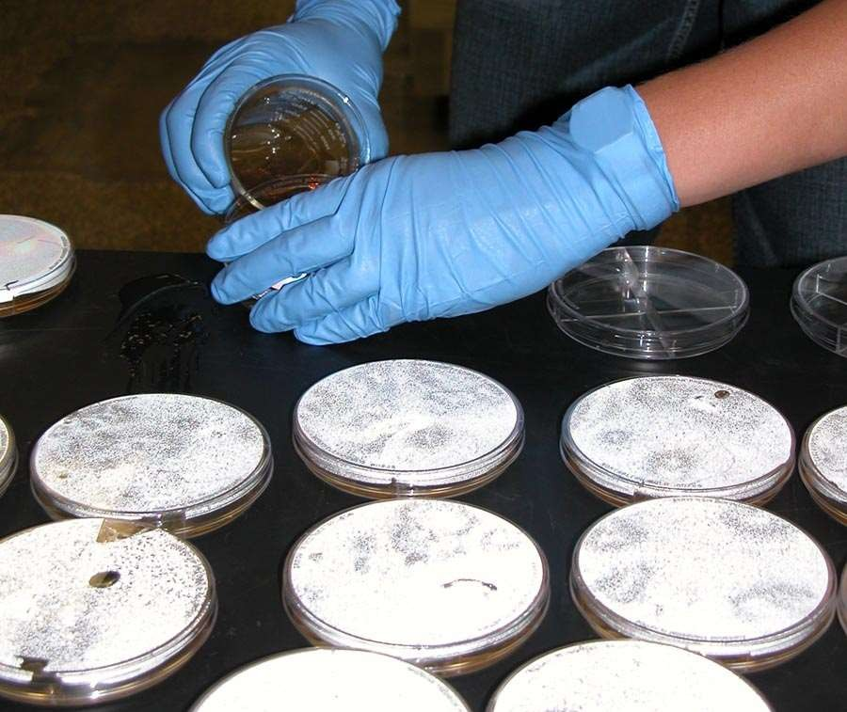
Line your sterile petri plates along the edge of the table. Pour 15-20 ml of the media into each petri plate. The petri plate lid should be open slightly, but not completely open as this increases contamination.

Slide 36
Lab exercise
Student will observe different types of culture media and try to identifiy each one of them.

