Slide 1
Forest and climate change
Global warming and Climate change
Global warming and climate change refer to the increase in average global temperatures due to the increase in greenhouse effect by the increase in the greenhouse gases.

Slide 2
Greenhouse effect
Weather and climate of the earth is driven by the sun’s energy. Solar radiation heats the earth surface, and in turn earth radiates the energy back into space. Some gasses of the atmosphere traps some of the outgoing energy and retains heat. This causes to an increase in the global temperature and also causes subsequent changes in the weather pattern.

Slide 3
Causes of climate change
Natural event : forest fires, volcanic eruptions, methane release from thawing of permafrost on the ocean floor and release of methane gas from cattle, wet lands
2. Anthropogenic activities : fossil oil combustion, industrial production of greenhouse gases, agricultural water lodging activities such as paddy cultivation artificial wet lands and deforestation.

Slide 4
Greenhouses gases
CO2 -Carbon dioxide
CH4-Methane
N20-nitrous oxide
HFC-hydro fluorocarbon
CFC-chlorofluorocarbon
CF4 -Carbon tetra fluoride

Slide 5
Major sources of Greenhouse gases
ENERGY | Forest fuel combustion ; Natural gas leakage ; Industrial activities; Biomass burning | CO2, CH4, N2O, O3
FOREST | Harvesting , Clearing . Burning | CO2, CH4, N2O
AGRICULTURE | Paddy fields , Animal husbandry (ruminants) , Fertilizer usage | CO2, CH4, N2O
WASTE MANAGEMNT | Sanitary landfill Incineration Biomass decay | CO2, CH4, N2O, O3, CFCs
INDUSTRIES | Metal smelting & processing ; Cement production ; Petrochemical production; Miscellaneous | CO2, CH4, N2O, CFCs, SF6, CF4, C2F6

Slide 6
Impacts of global warming
Sea level rise
Melting down of ice
Extreme events (flood & landslides, Hurricanes and Tornadoes, droughts and fires, heat waves)
Effect on biodiversity
Health effects

Slide 7
Key definitions
Carbon pool: A reservoir of carbon. A system which has the capacity to accumulate or release carbon.
Carbon stock: The absolute quantity of carbon held within a pool at a specified time. The units of measurement are mass.
Carbon flux: Transfer of carbon from one carbon pool to another in units of measurement of mass per unit area and time (e.g., t C ha-1 yr-1)
Carbon sink: Any process or mechanism which removes a greenhouse gas, an aerosol or a precursor of a greenhouse gas from the atmosphere. A given pool (reservoir) can be a sink for atmospheric carbon if, during a given time interval, more carbon is flowing into it than is flowing out.
Sequestration (uptake): The process of increasing the carbon content of a carbon pool other than the atmosphere.(IPCC, 2000).

Slide 8
Roles of forestry in climate change
Forests are important carbon pools which continuously exchange CO2 with the atmosphere.
Organic matter contains carbon susceptible to be oxidized and returned to the atmosphere in the form of CO2. Carbon is found in several pools in the forest:

Slide 9
Con’t
the vegetation: living plant biomass consisting of wood and non-wood materials.
dead wood and litter: dead plant biomass, made up of plant debris.
soil organic matter, the humus. Humus originates from litter decomposition.
Wood products derived from harvested timber are also significant carbon pools.

Slide 10
Process of CO2 emission
The oxidation of carbon found in organic matter and the subsequent emissions of CO2 result from the following processes:
• respiration of living biomass,
• decomposition of organic matter by other living organisms (also called heterotrophic
respiration),
• combustion (fires)

Slide 11
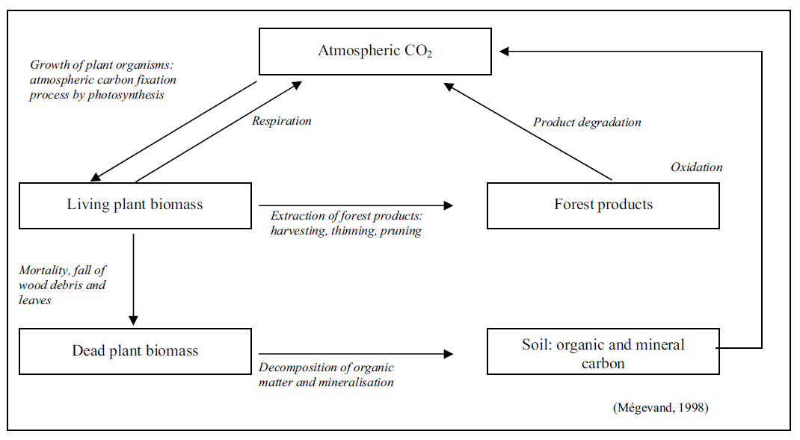
Diagram of Carbon cycle in forest

Slide 12
Con’t
The participation of forests in climate change is thus three-fold:
- they are carbon pools
- they become sources of CO2 when they burn, or, in general, when they are disturbed by natural or human action
- they are CO2 sinks when they grow biomass or extend their area.

Slide 13
Con’t
The carbon cycle (photosynthesis, plant respiration and the degradation of organic matter)in a given forest is influenced by climatic conditions and atmospheric concentrations of CO2.

Slide 14
Forestry activities to mitigate climate change
Several actions can be taken in the forestry sector in order to mitigate climate change.
Plant trees to create carbon sinks
Planting new forests, rehabilitating degraded forests and enriching existing forests
Protect existing forests to reduce emissions from deforestation
The carbon reservoir in the forest biomass and soils is very large, highlighting the importance of conserving natural forests.

Slide 15
Improve forestry techniques to reduce emissions
practices such as improved forest harvesting techniques, reducing wood wastes reduce emission
Wood acting as a substitute for fossil fuels and energy-intensive materials

Slide 16
Replacing high-energy materials with climate-friendly substitutes
Using lumber instead of materials requiring large amounts of energy during production helps fight the greenhouse effect, e.g. in replacing concrete or steel constructions by wood as frames, beams, etc.

Slide 17
Fossil fuel substitution through renewable wood energy
Producing wood for energy purposes mitigates climate change by combining sink action with emissions reduction.
Substituting fossil fuels, such as coal, natural gas, or oil by fuelwood for domestic use, electricity production, or industrial use, e.g. in iron smelters, reduces CO2 emissions because wood is renewable

